Slide 1

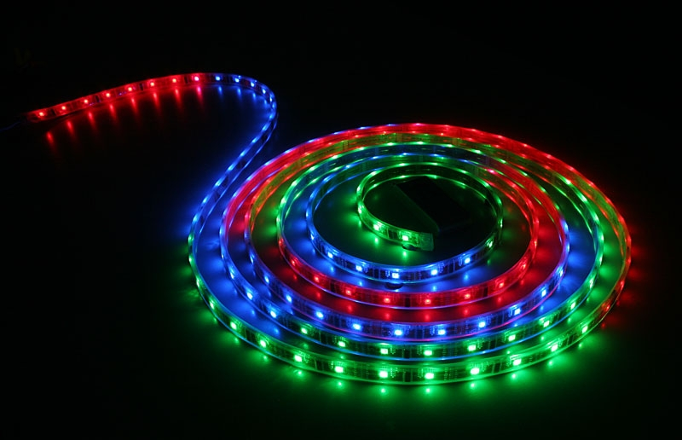
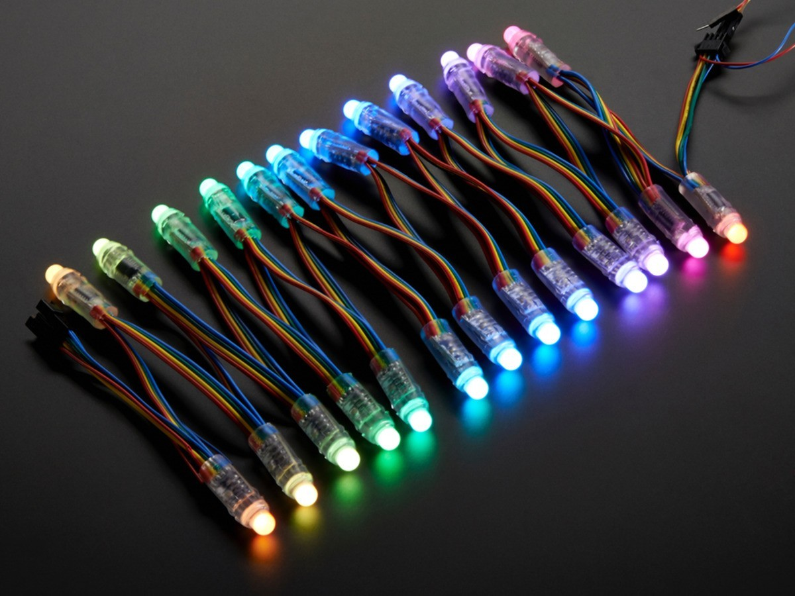
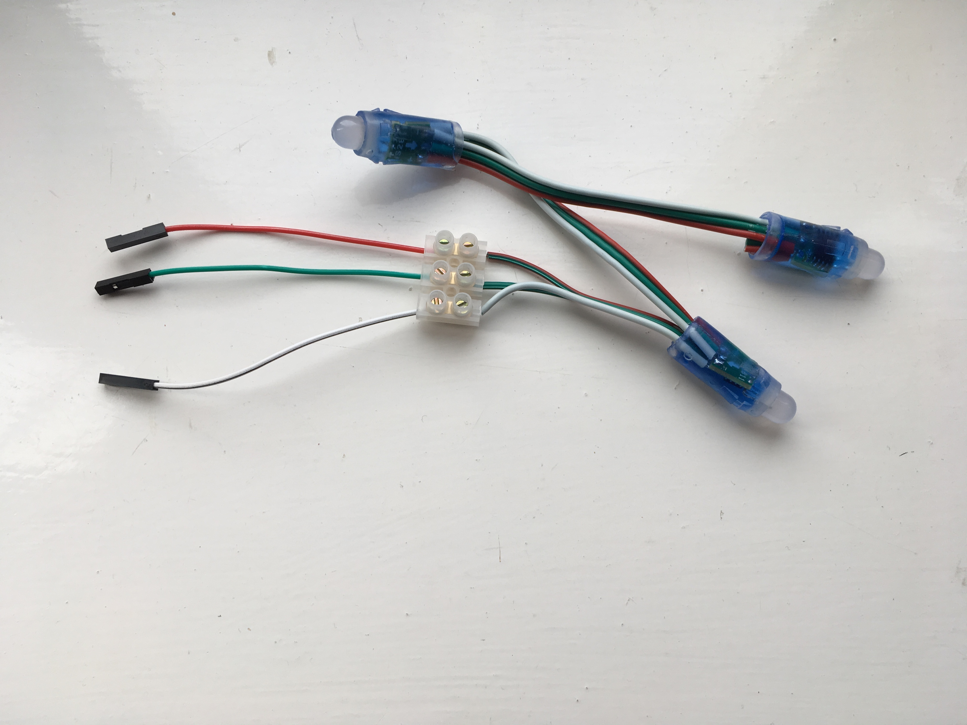
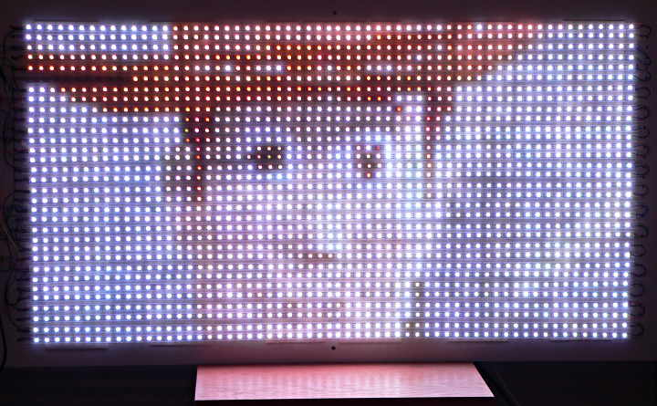
Raspberry Pi Individually Addressable LEDs
Cotswold Raspberry Jam
Saturday 2nd March 2019

Slide 2
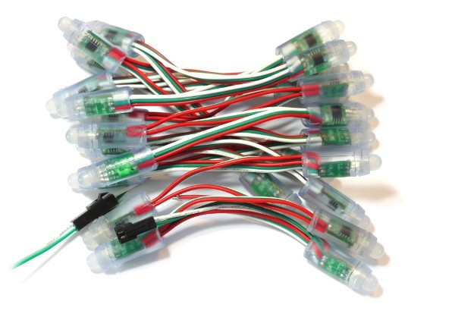
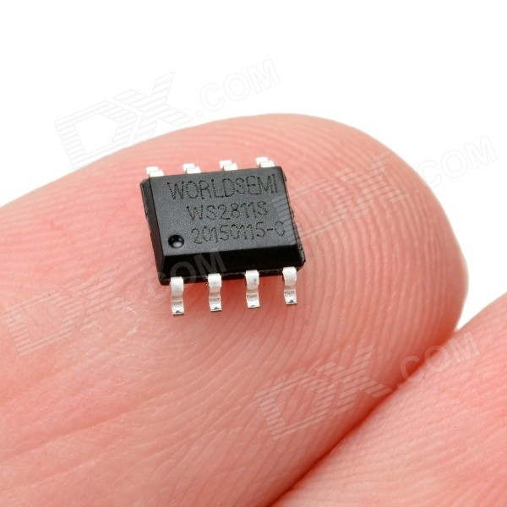
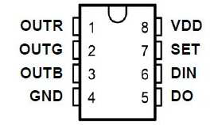
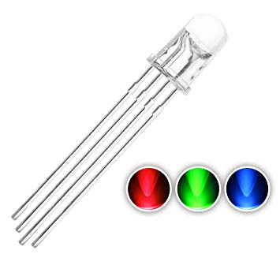
ws2811

Slide 3
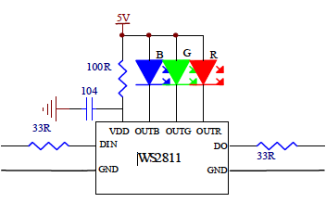
RGB
Each LED is actually 3
RED
GREEN
BLUE
Individually set each R G B to brightness between 0 and 255
Each colour LED takes 8 bits
Each bulb (3 colours) takes 3 x 8 bits = 24 bits

Slide 4
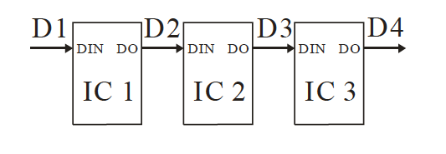
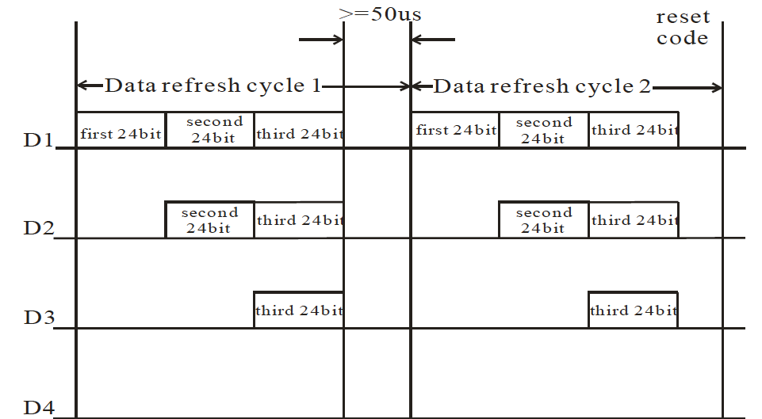

Slide 5
PLEASE
Make sure the Pi is turned off
before you start wiring
&
Get your wiring checked
before you turn the Pi on

Slide 6
mytest.py
import board
import neopixel
import time
pixels = neopixel.NeoPixel(board.D18, 3, auto_write=False)
pixels[0] = (255, 0, 0)
pixels[1] = (0, 255, 0)
pixels[2] = (0, 0, 255)
pixels.show()
time.sleep(2)
pixels.fill((0, 0, 0))
pixels.show()

